Slide 1
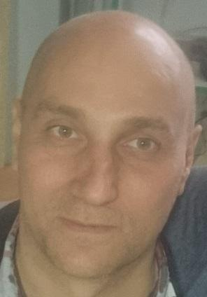
CS50 Final Project
My name is Oleksii Moskovskyi
I am in Kharkiv, Ukraine
My project name: Alarm Scanner
GitHub: amoskovskij
edX: amoskovskij
Date: 2024-06-23.

Slide 2
Project goal
The city of Kharkiv is under daily fire from the Russian Federation.
It is impossible to stay in shelter continuously.
It is necessary to monitor several Telegram channels of observers, and in the event of a threat to my area of ​​the city, receive an alert and go to the shelter in time.

Slide 3
Project details
The project is developed on Java 8, JavaFx
Lists of URLs of Telegram channels and key phrases are stored in text files
Every 30 seconds, messages for the last 15 minutes are received from one of the sources.
If one of the key phrases is detected, an audio and text notification occurs.

Slide 4
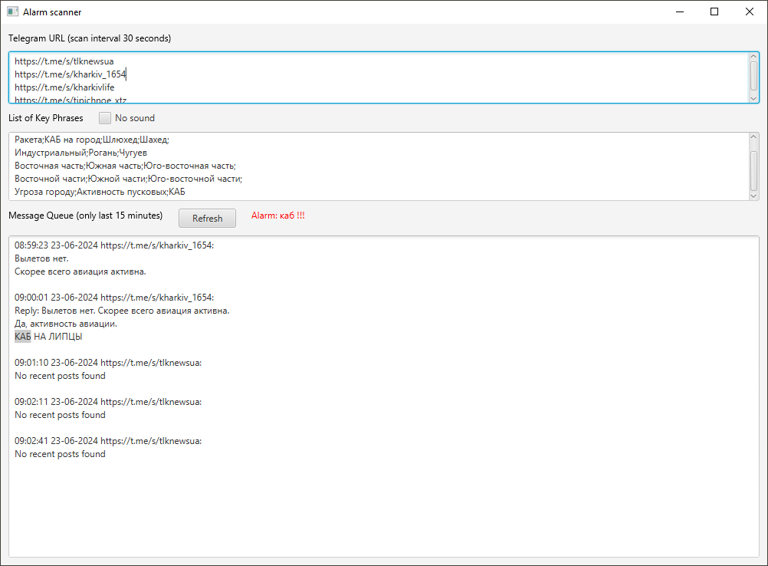

Slide 5
Conclusion
I found the CS50 course very interesting and useful.
I wanted to take additional courses in Cybersecurity, Python, Databases and Web programming.
This is my second project using JavaFx.
Working on it was very educational for me.

